Slide 2
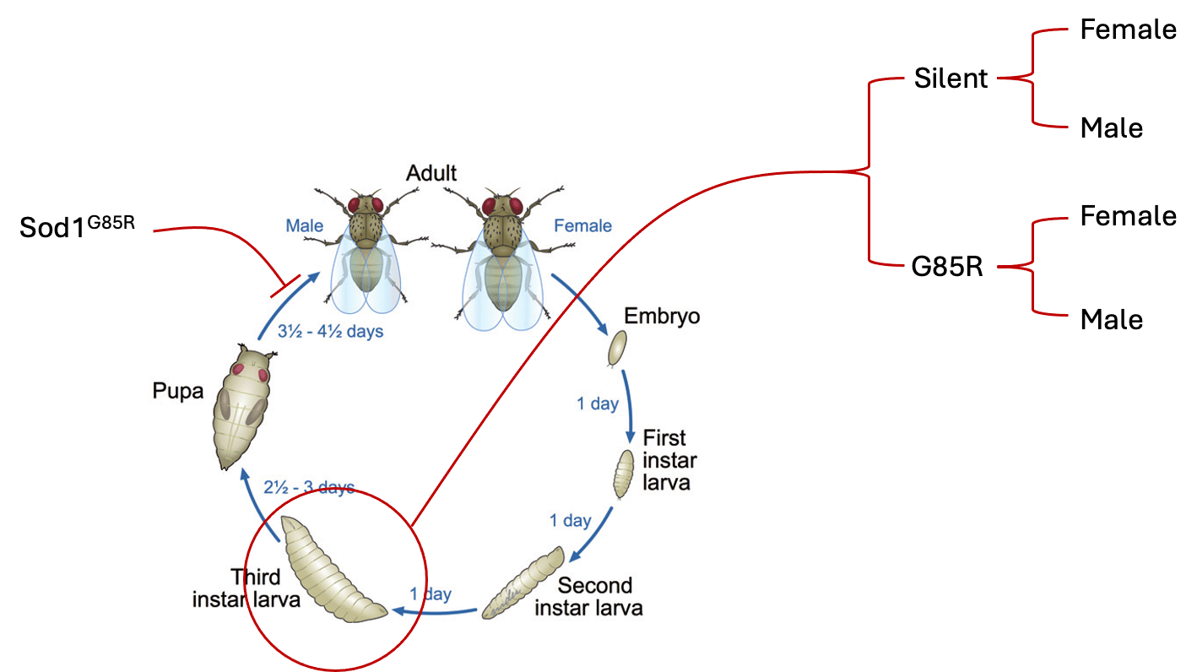
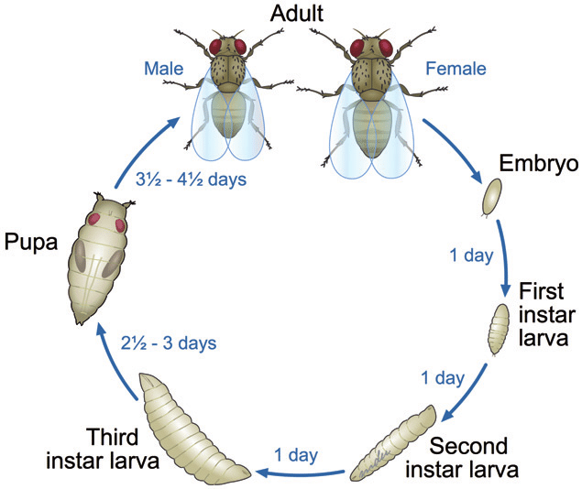
SOD1^{G85R} RNAseq Experimental Design
Female
Silent
Male
Female
RNAseq
Sod1^{G85R}
G85R
Male
Sod1^{G85R} flies are unable to eclose
We performed RNAseq Sod1^{G85R} and Silent 3rd instar larvae (whole body) separated by sex

Slide 3
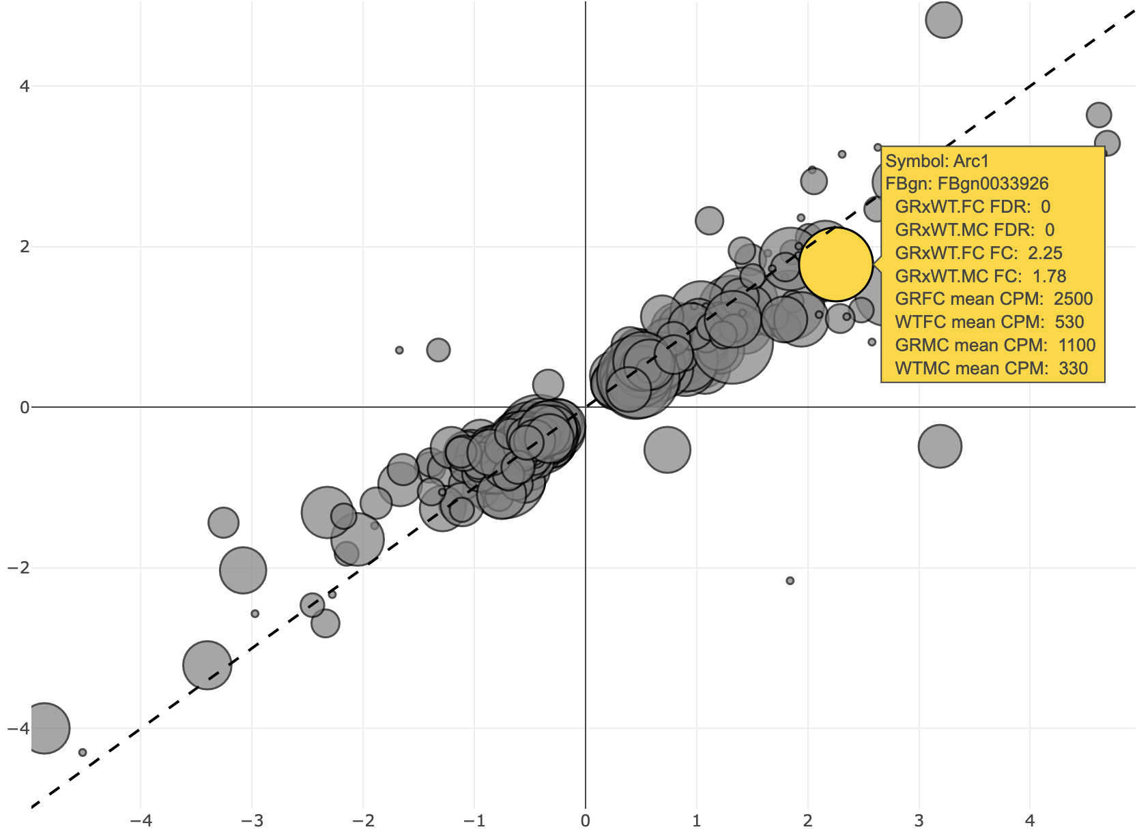
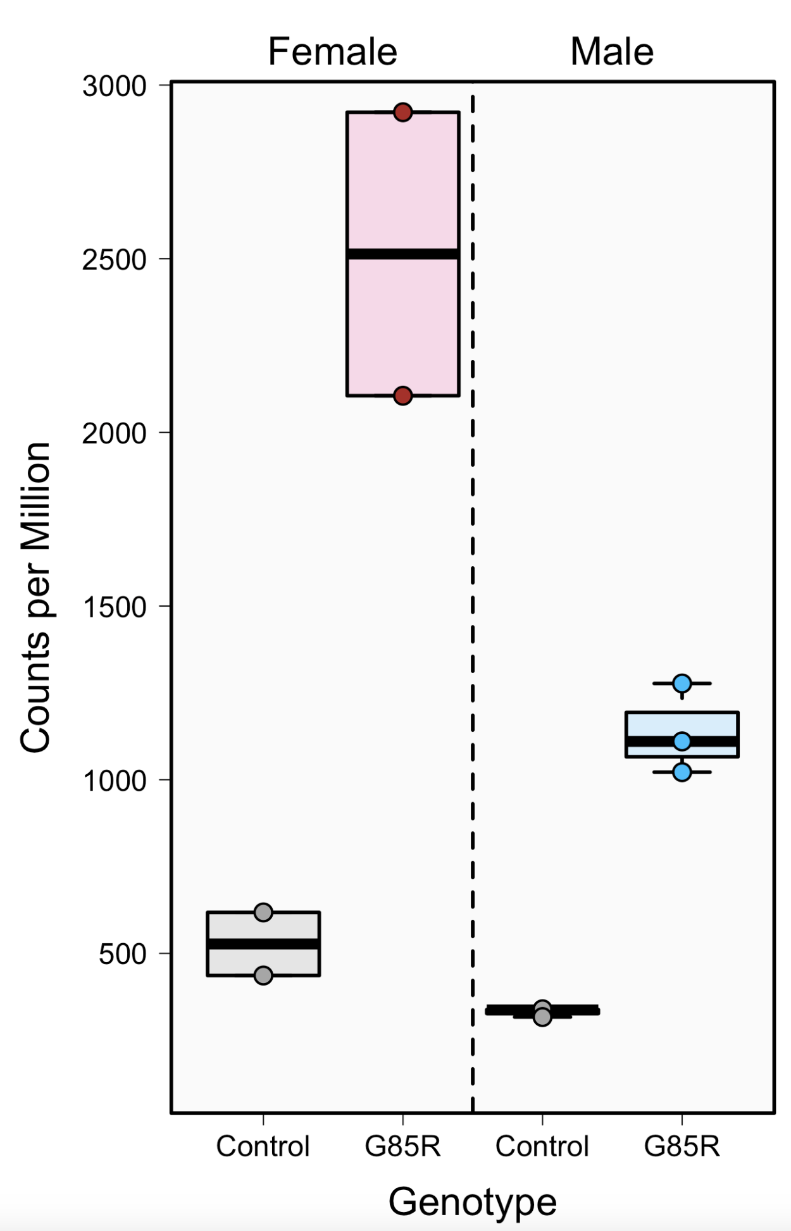
Arc1 Increased Expression in G85R Transcriptome Analysis
Female and Male Relative Gene Expression (G85R/WT)
Arc1
Male –log2(FC)
Female –log2(FC)

Slide 4
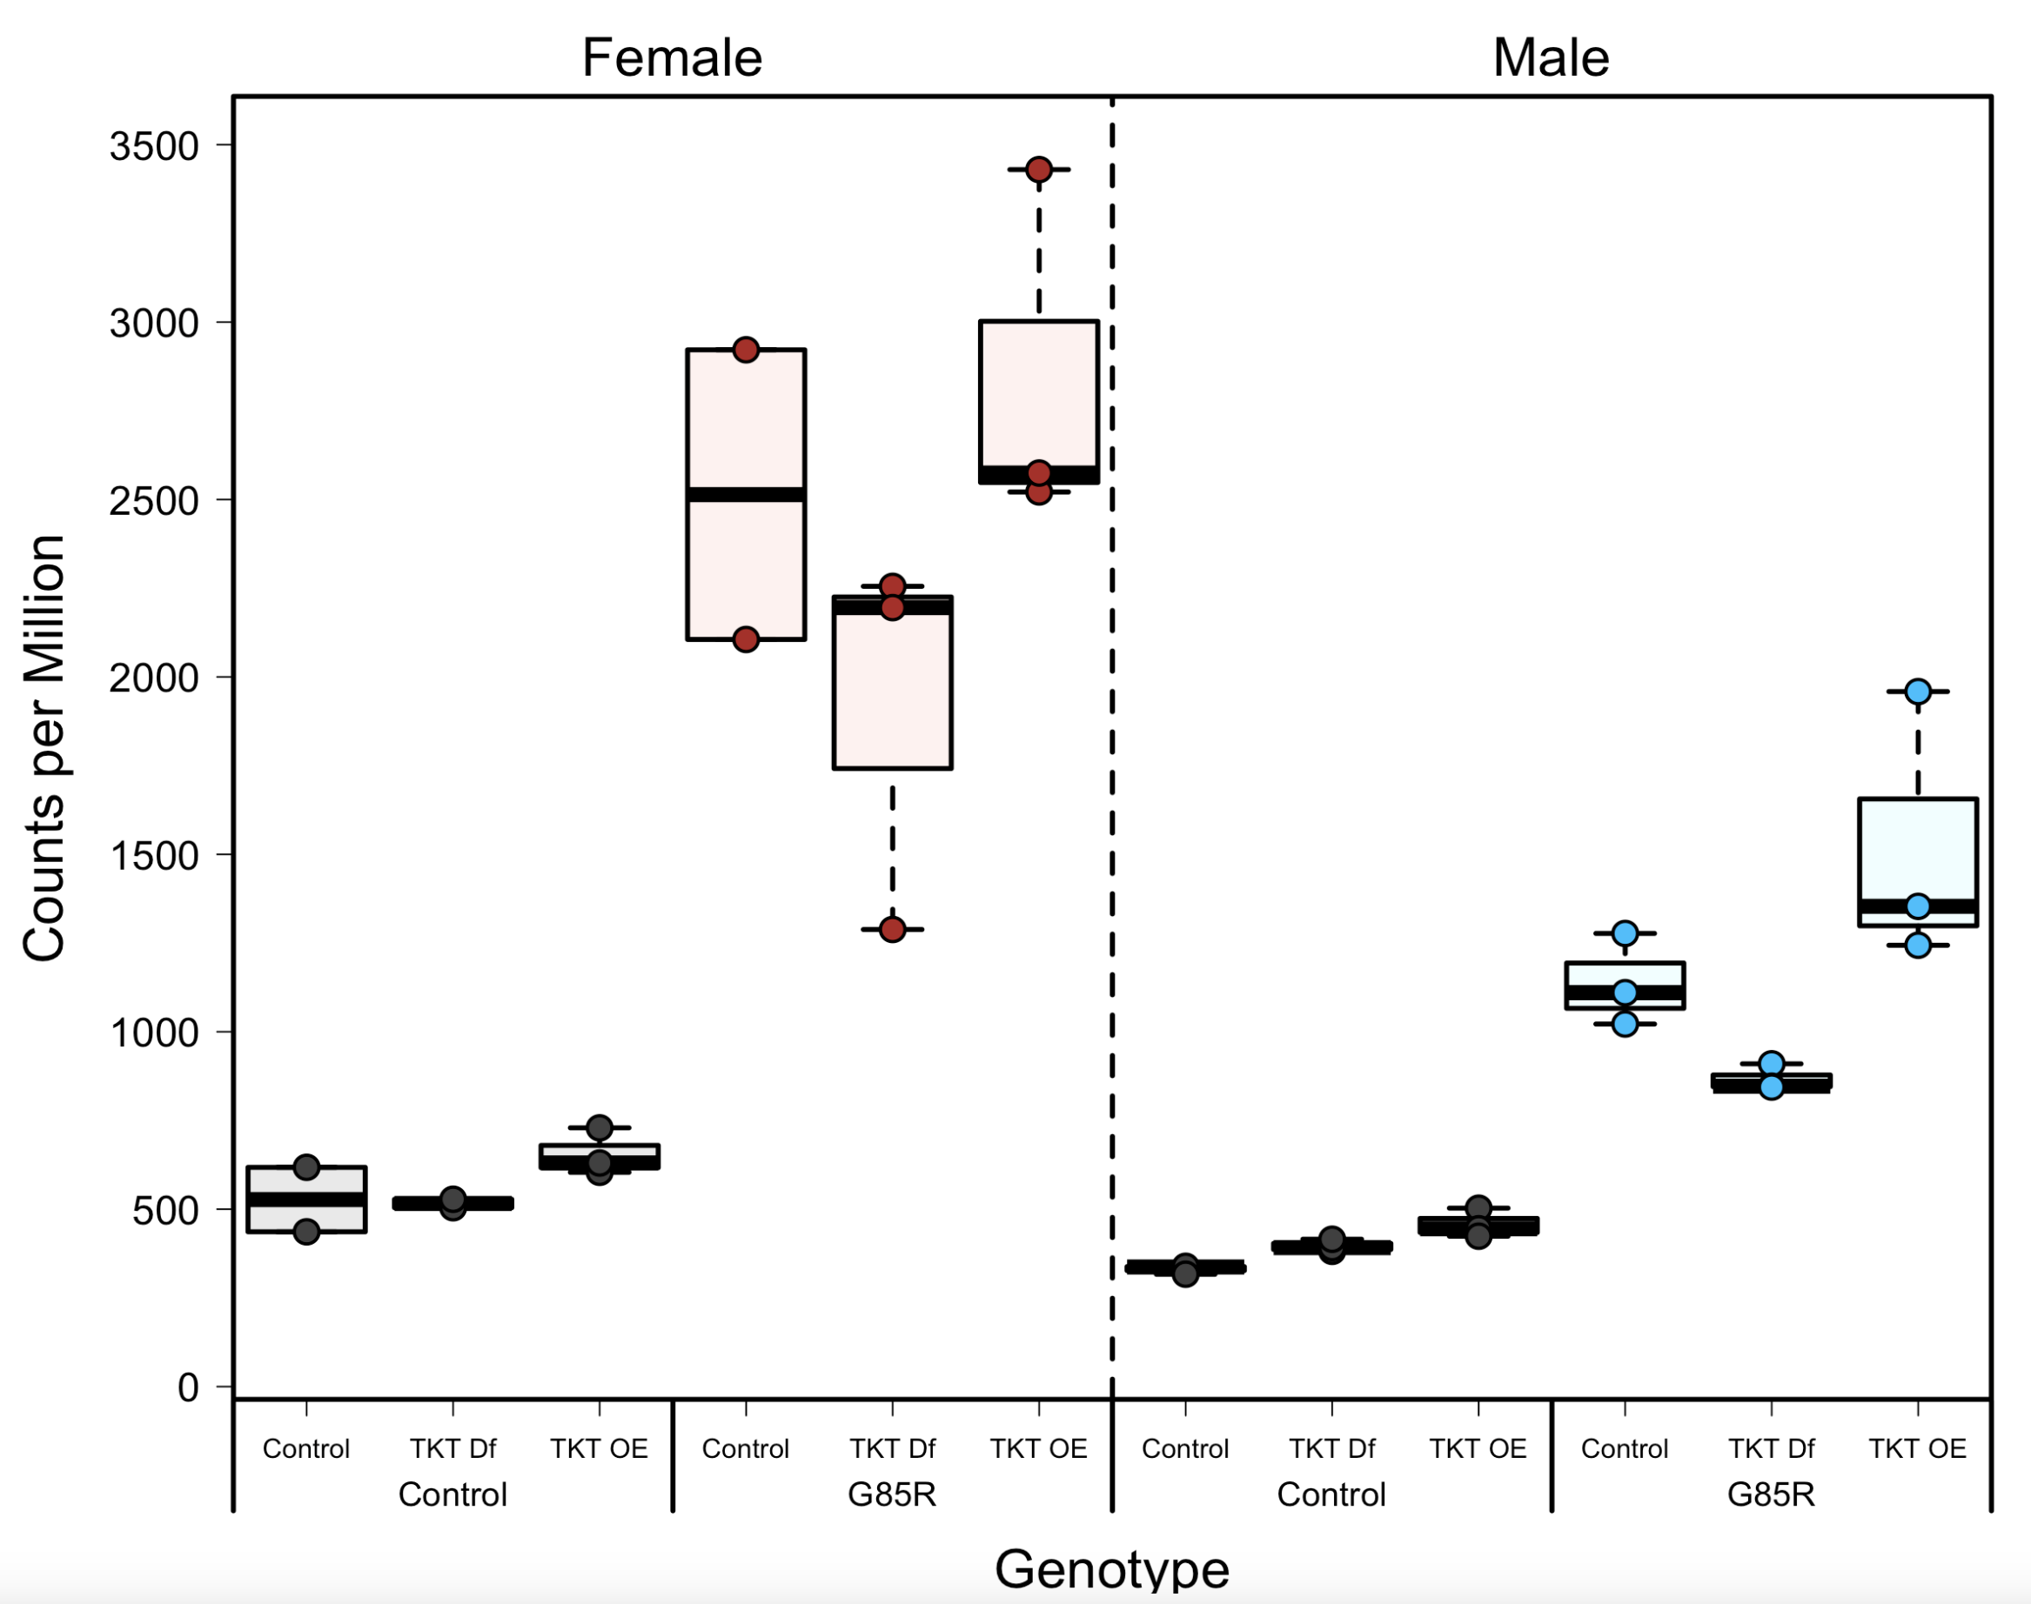
G85R arc1 increase observed in other conditions
Arc1
The G85R RNAseq data was part of a larger experiment with modulated transketolase
Arc1 gene expression was observed consistently across these other experimental conditions

Slide 5

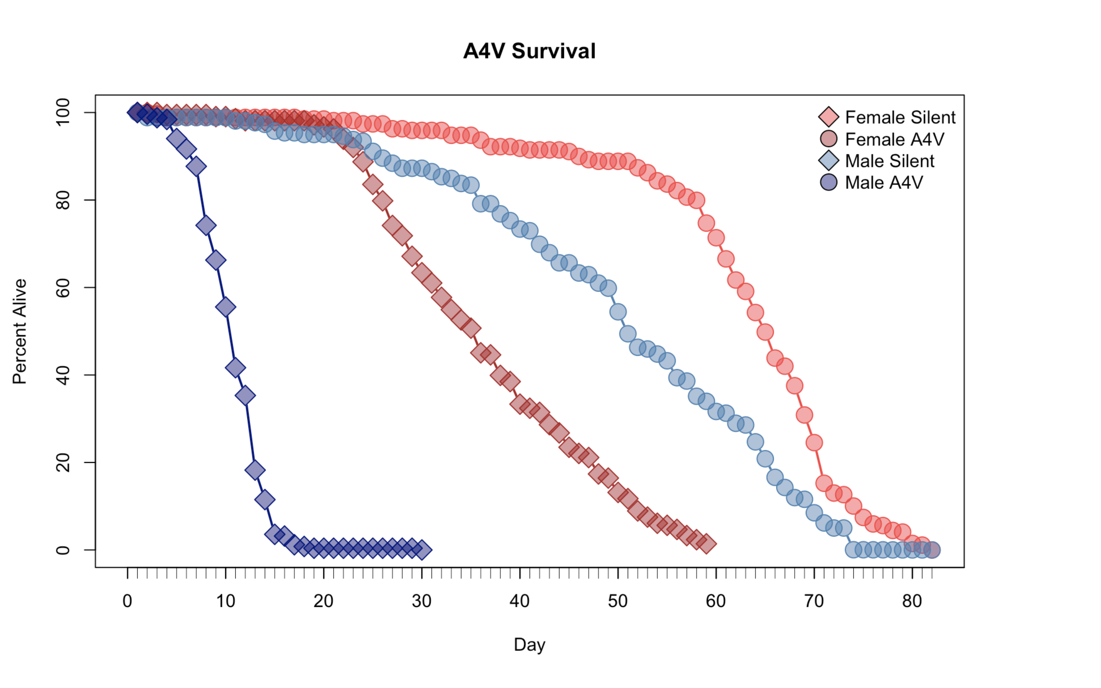
Sod1^{A4V} RNAseq Experimental Design
Head
Thorax
Sod1^{A4V} flies have sex specific decreased lifespan
Sod1^{A4V} and Silent adults at 3, 9, and 40 days, old separated by sex
Samples were separated into 3 body sections before RNAseq
Abdomen
Sod1^{A4V} flies have sex specific decreased lifespan
We performed RNAseq on Sod1^{A4V} and Silent adulst at 3, 9, and 40 days old separated by sex

Slide 6
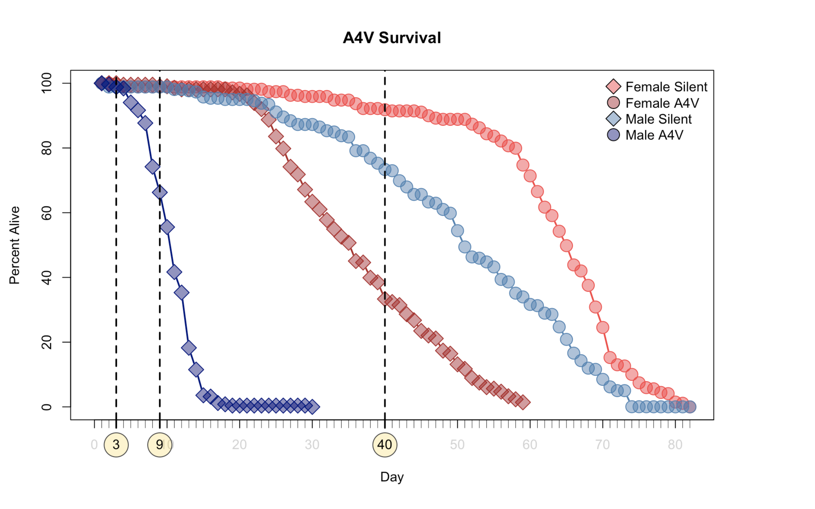
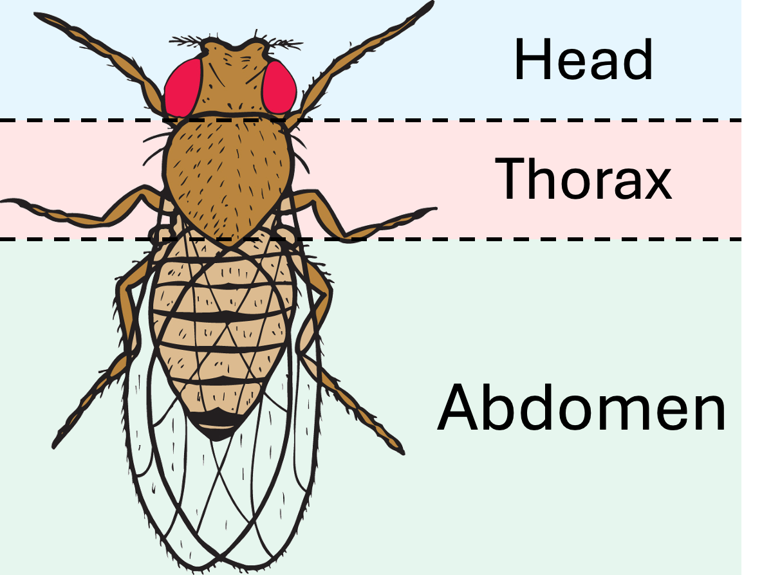
Sod1^{A4V} RNAseq Experimental Design
Sod1^{A4V} flies have sex specific decreased lifespan
Sod1^{A4V} and Silent adults at 3, 9, and 40 days, old separated by sex
Samples were separated into 3 body sections before RNAseq

Slide 7
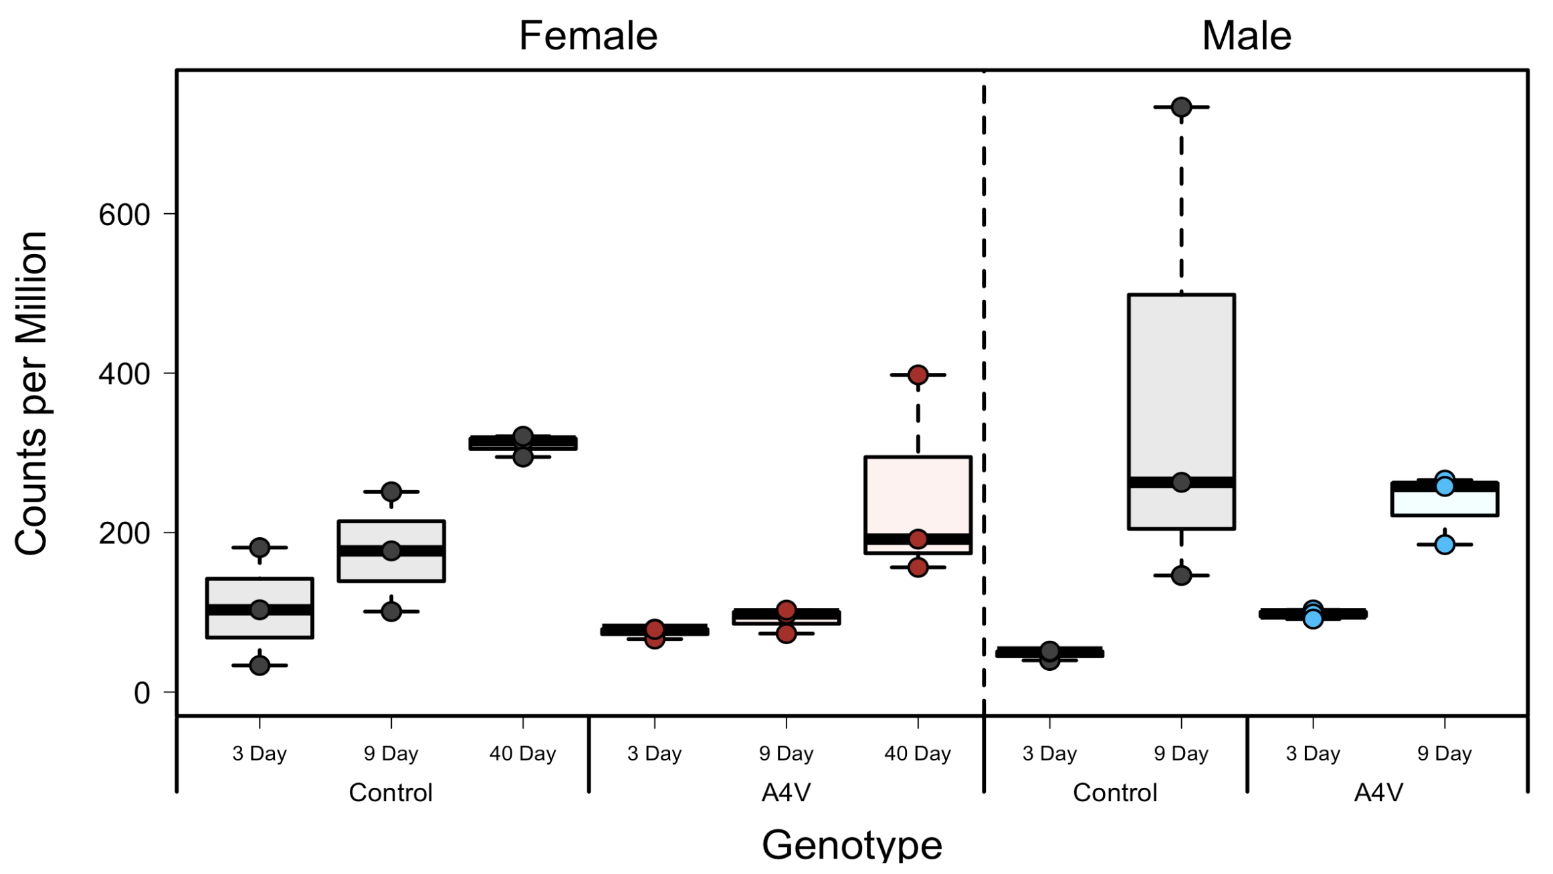
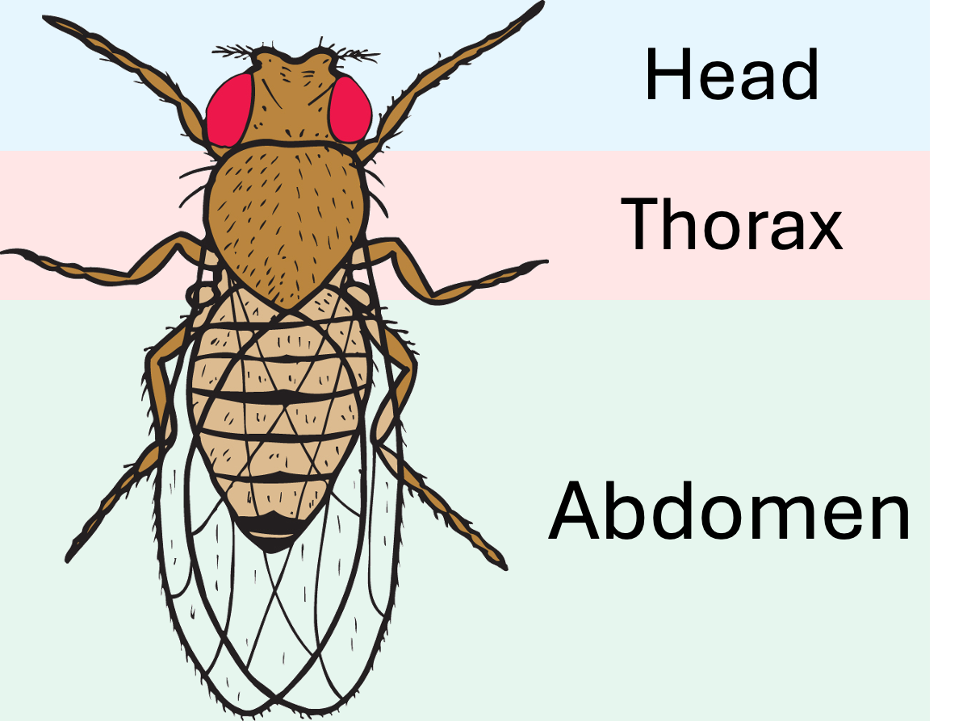
Arc1 Expression in Sod1^{A4V} Head
Sod1^{A4V} flies have sex specific decreased lifespan
Sod1^{A4V} and Silent adults at 3, 9, and 40 days, old separated by sex
Samples were separated into 3 body sections before RNAseq

Slide 8
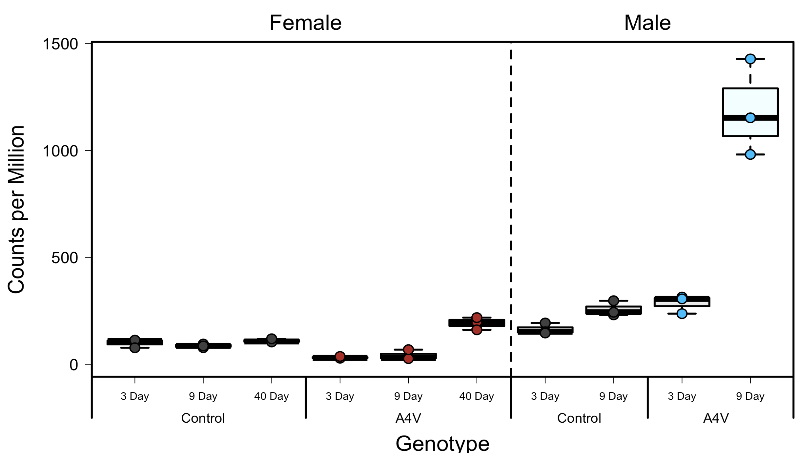
Arc1 Expression in Sod1^{A4V} Abdomen
Sod1^{A4V} flies have sex specific decreased lifespan
Sod1^{A4V} and Silent adults at 3, 9, and 40 days, old separated by sex
Samples were separated into 3 body sections before RNAseq

Slide 9
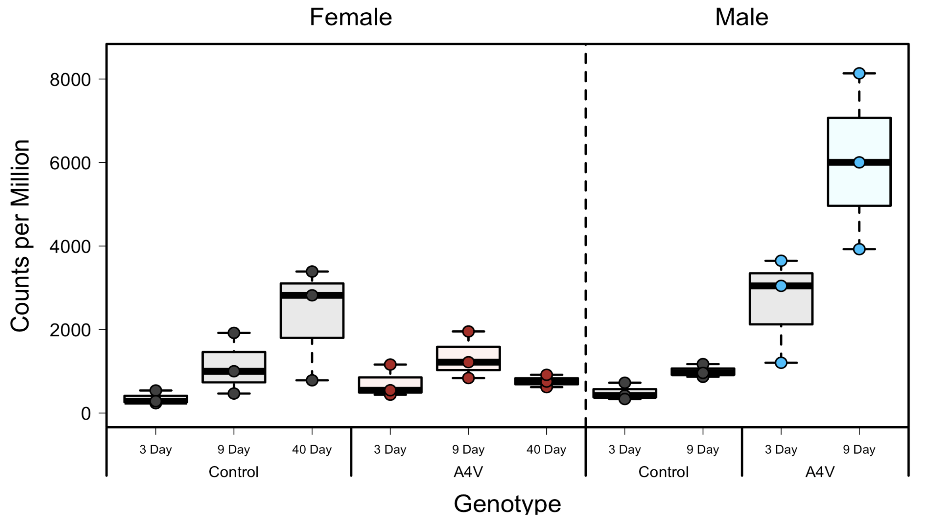
Arc1 Expression in Sod1^{A4V} Thorax
Sod1^{A4V} flies have sex specific decreased lifespan
Sod1^{A4V} and Silent adults at 3, 9, and 40 days, old separated by sex
Samples were separated into 3 body sections before RNAseq

Slide 10
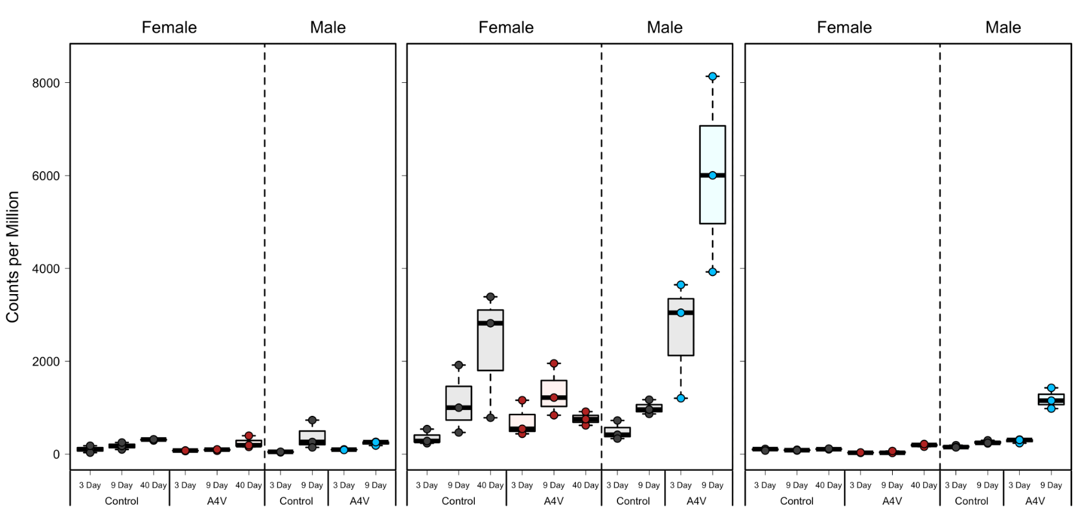
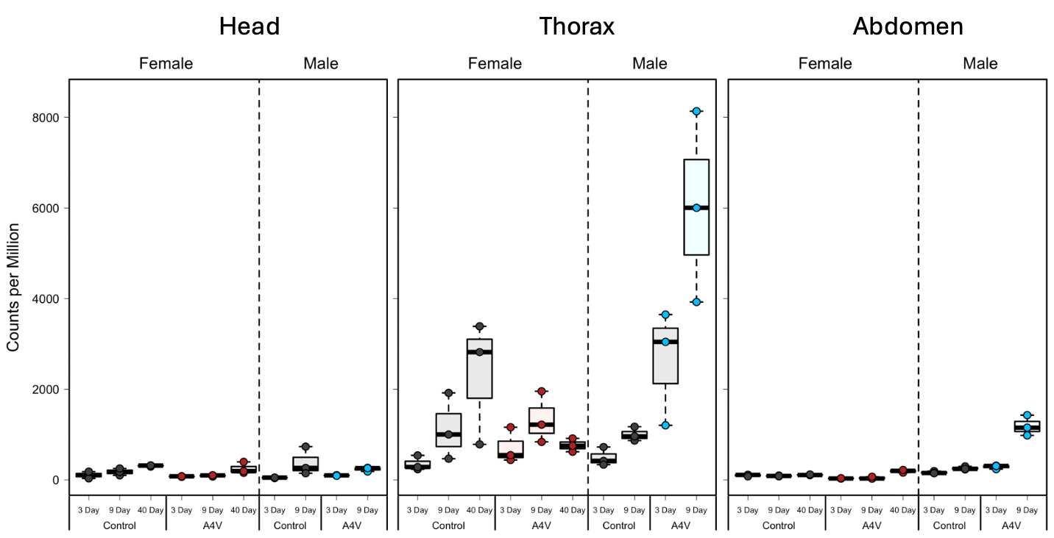
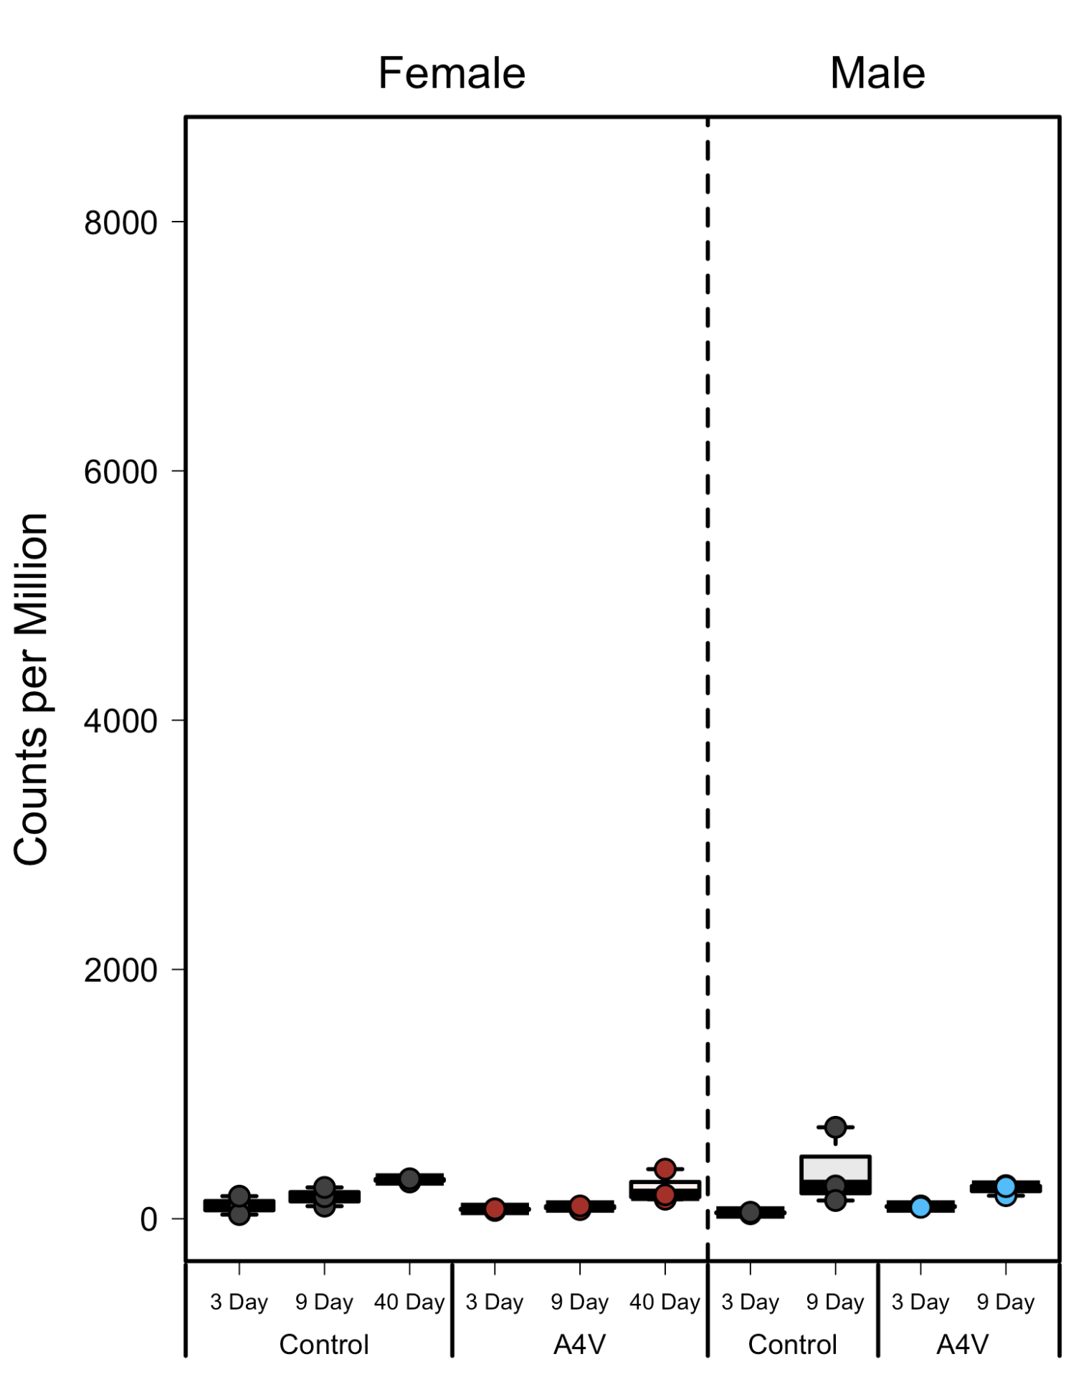
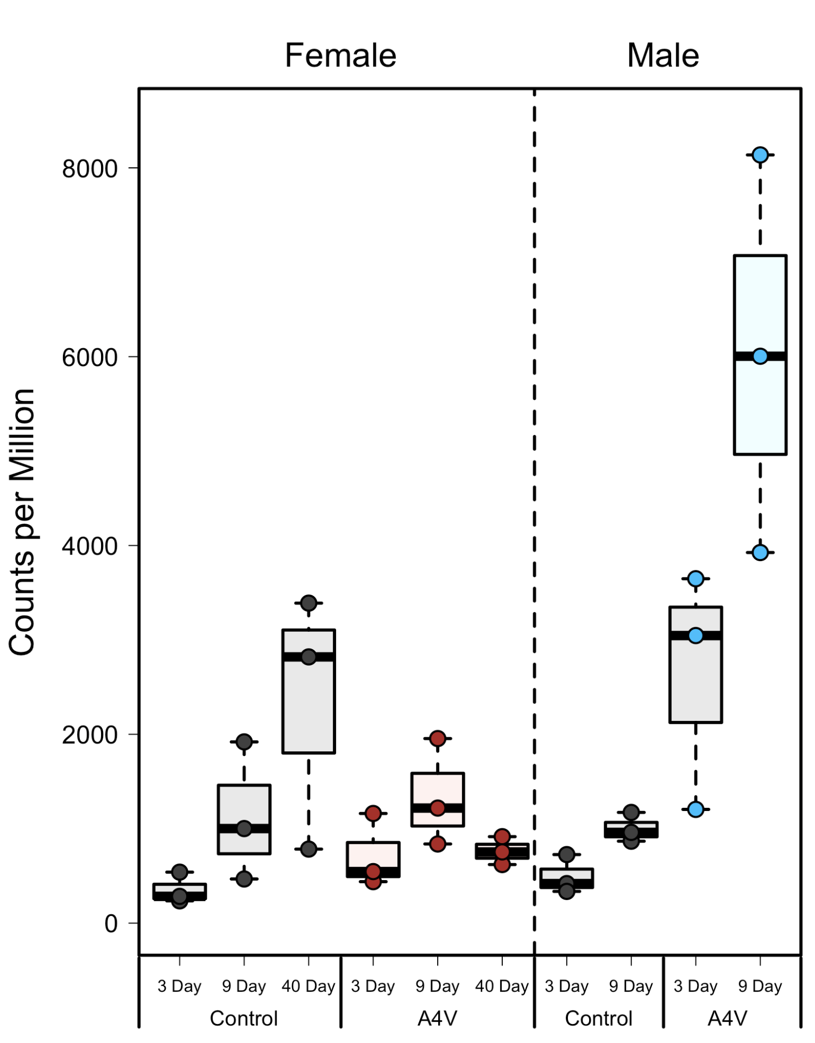
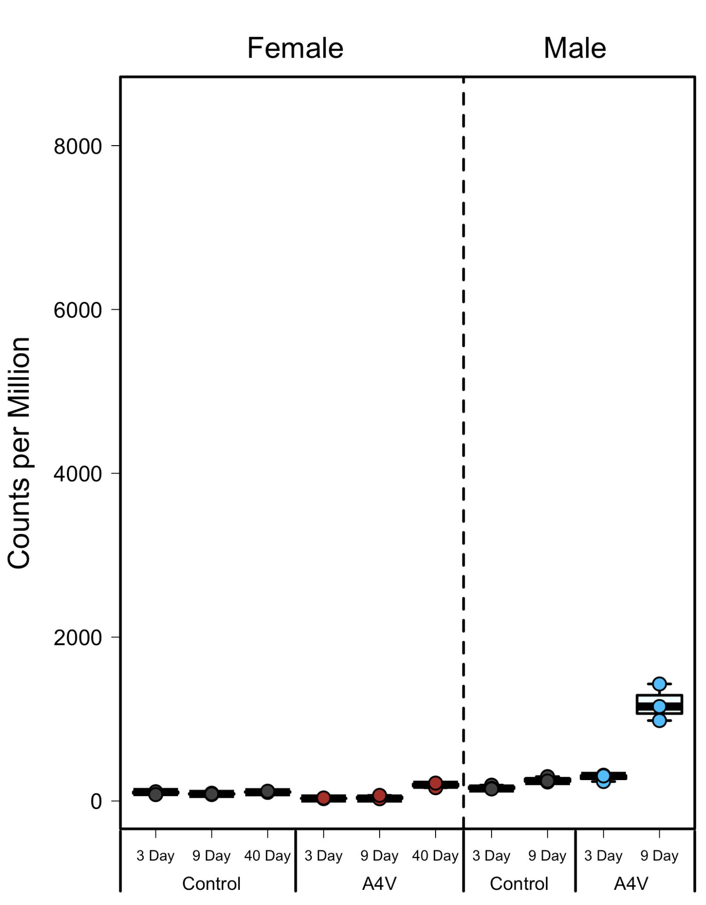
Arc1 Expression in Sod1^{A4V}
Head
Thorax
Abdomen

Slide 11
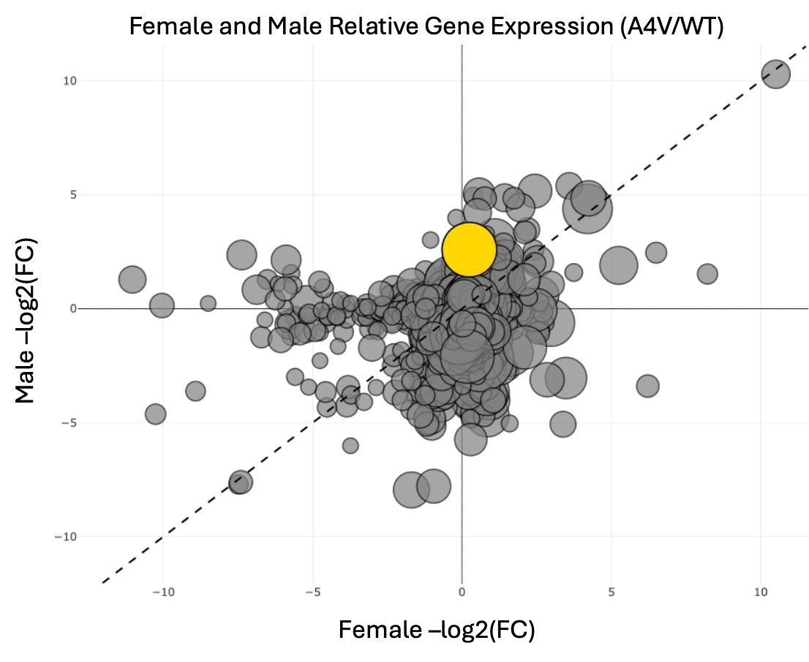
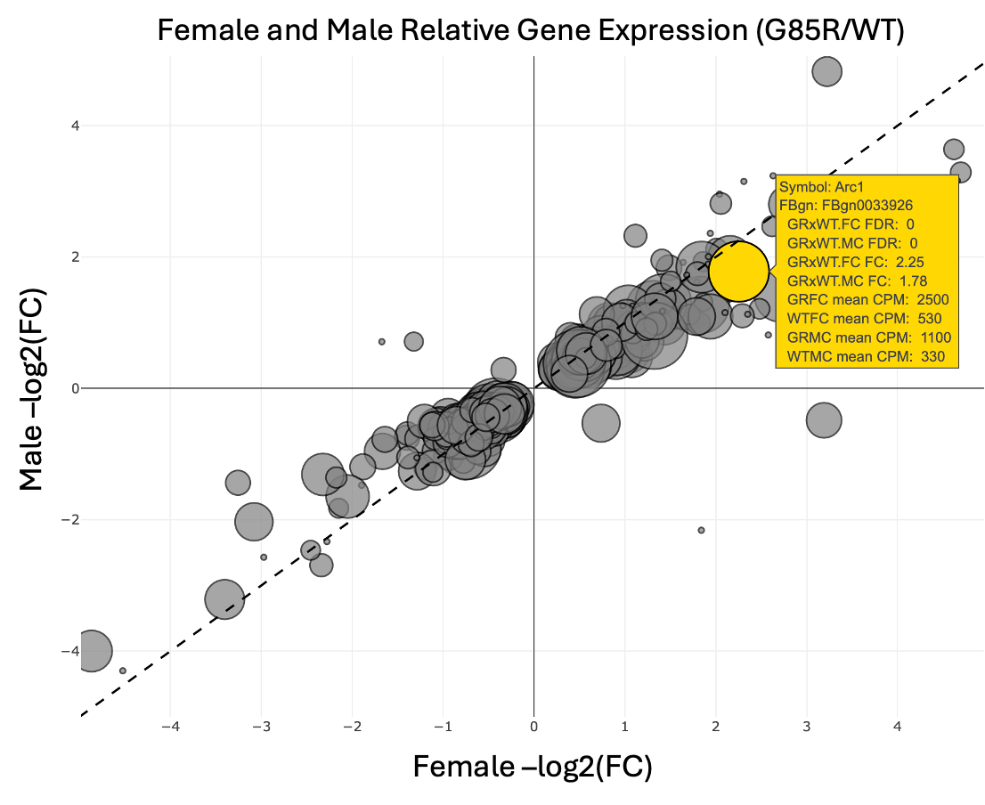
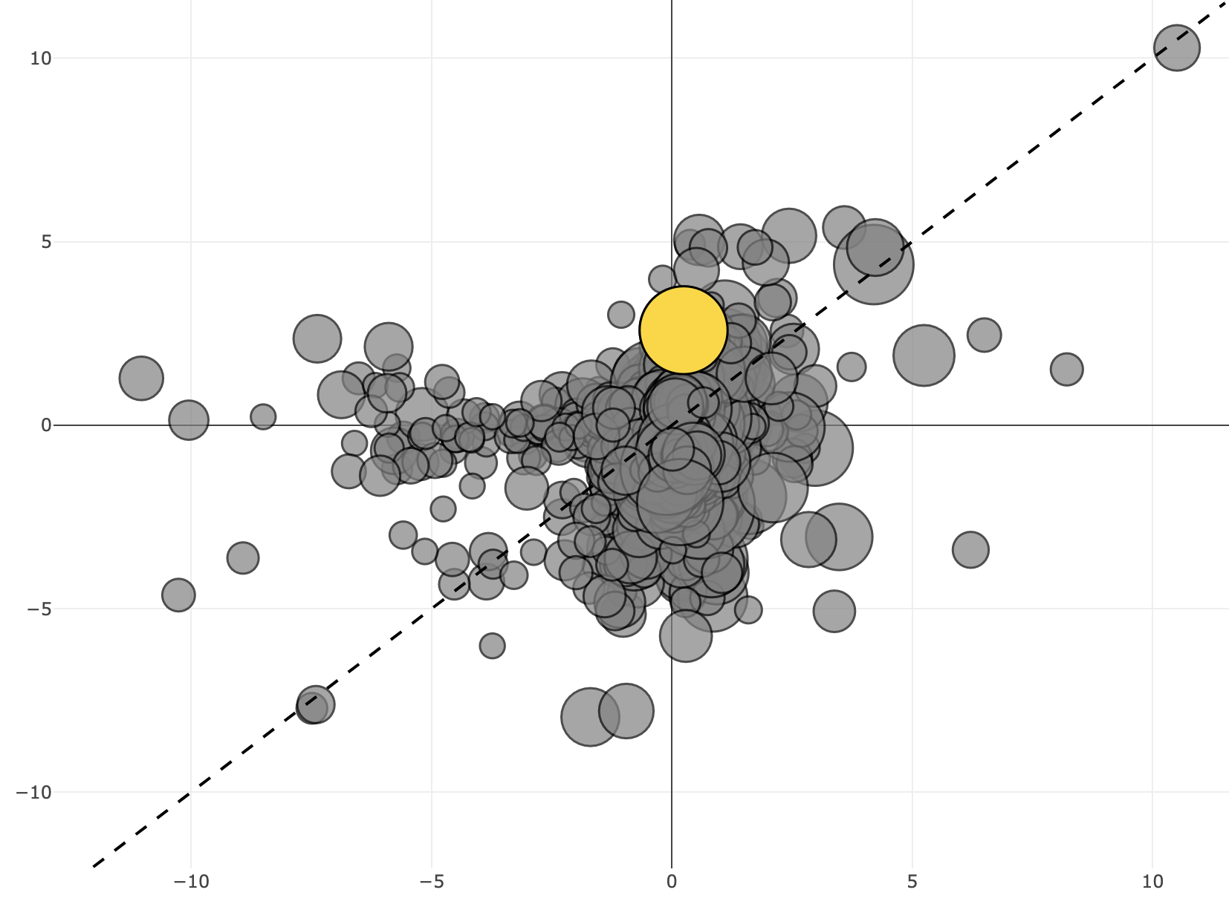
Distinct Sex Differences in Sod1^{A4V} Transcriptome
Female and Male Relative Gene Expression (A4V/WT)
Male –log2(FC)
Unlike in Sod1^{G85R} larvae, the transcriptome profiles between male and female Sod1^{A4V} thorax samples
Female –log2(FC)

Slide 12
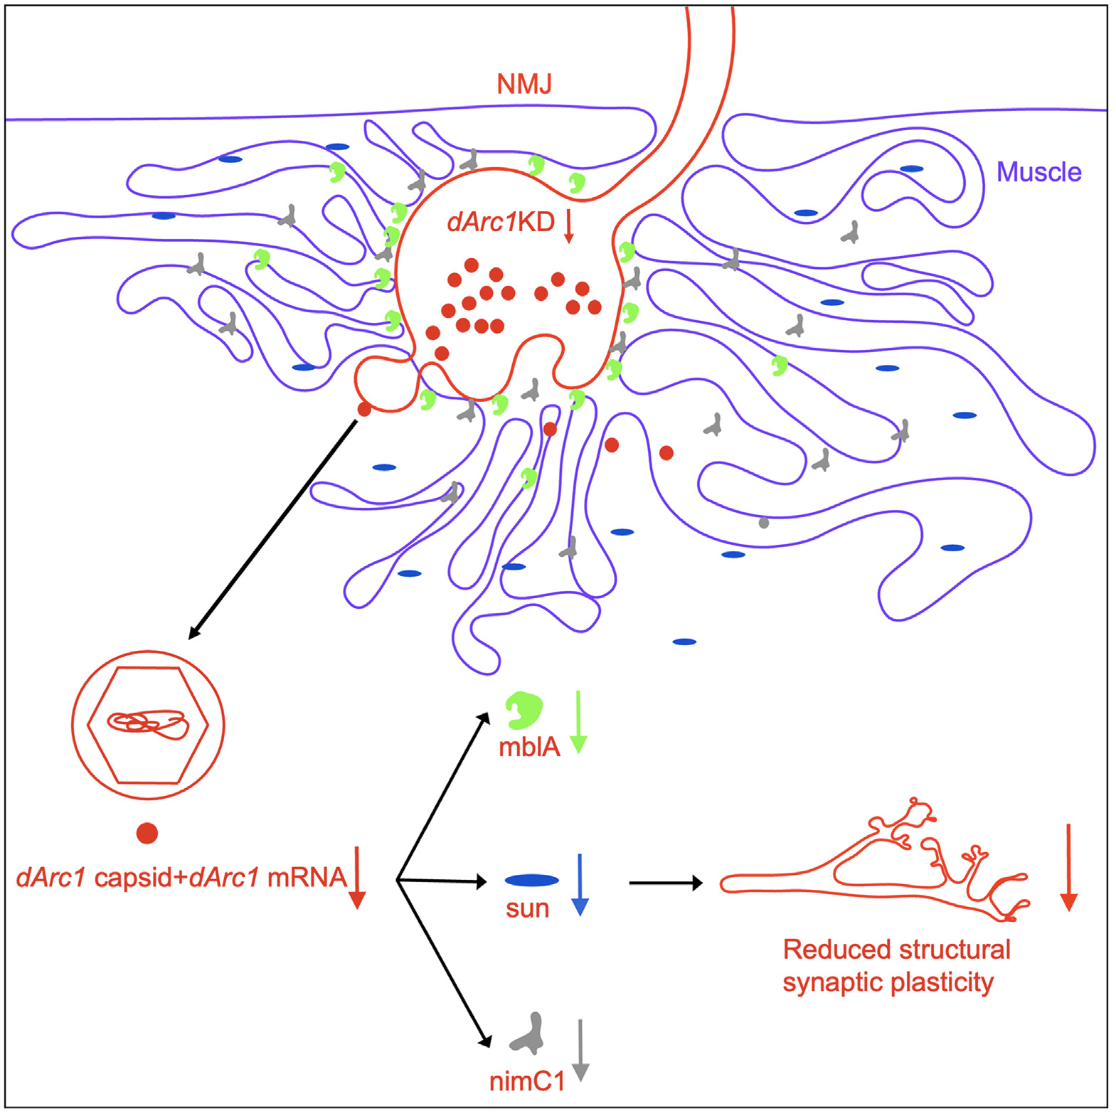
Could Arc1 mRNA increased be associated with sequestering by dArc1 capsid?
If so, would potentially see increase in other dArc1 capsid binding mRNAs

Slide 13
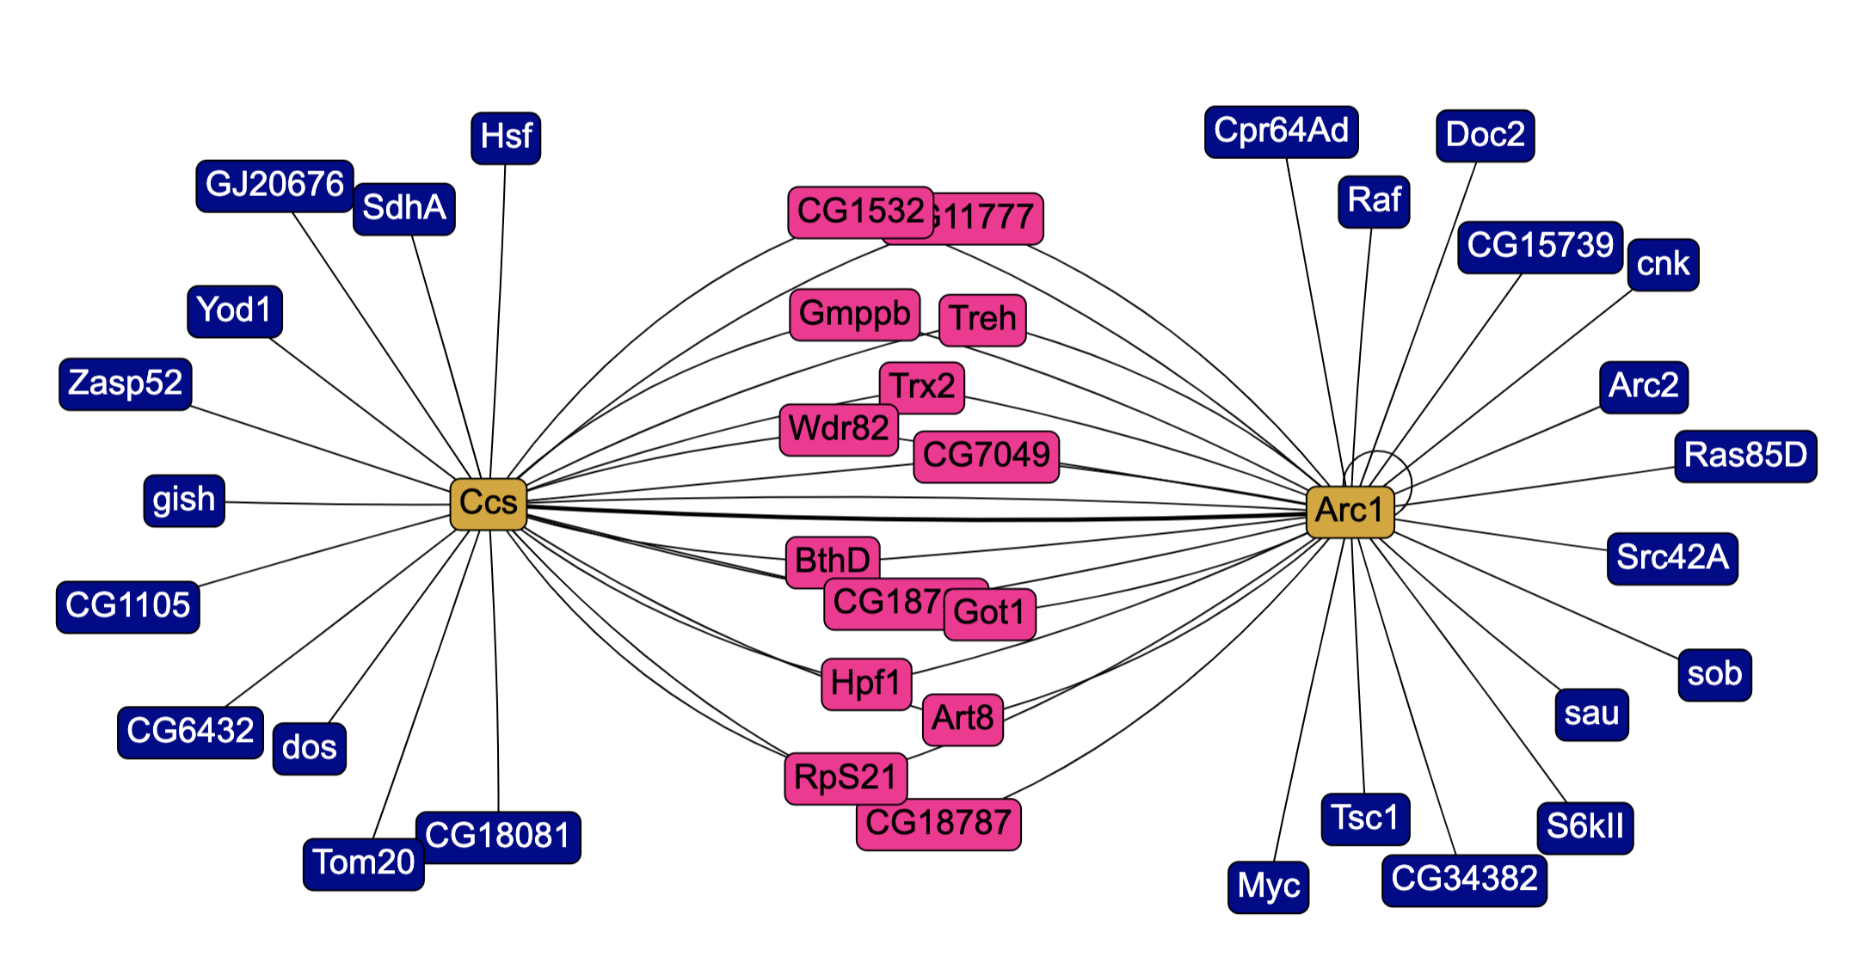
arc1 and sod1 network?
Ccs
Arc1
arc1 binding diagram
a what is ccs image
Ccs and Arc1 shared binding diagram

Slide 14
Questions
validate arc1 expression
look at other models for arc1 expression
A4V larvae?
A4V pharates?
Is it elevated in other publicly available datasets?
look at protein levels
could this be different between males and females? related to translation levels?
look at localization
where does travis
TE specific RNAseq mapping
Is it elevated in other publicly available datasets?

